Slide 1
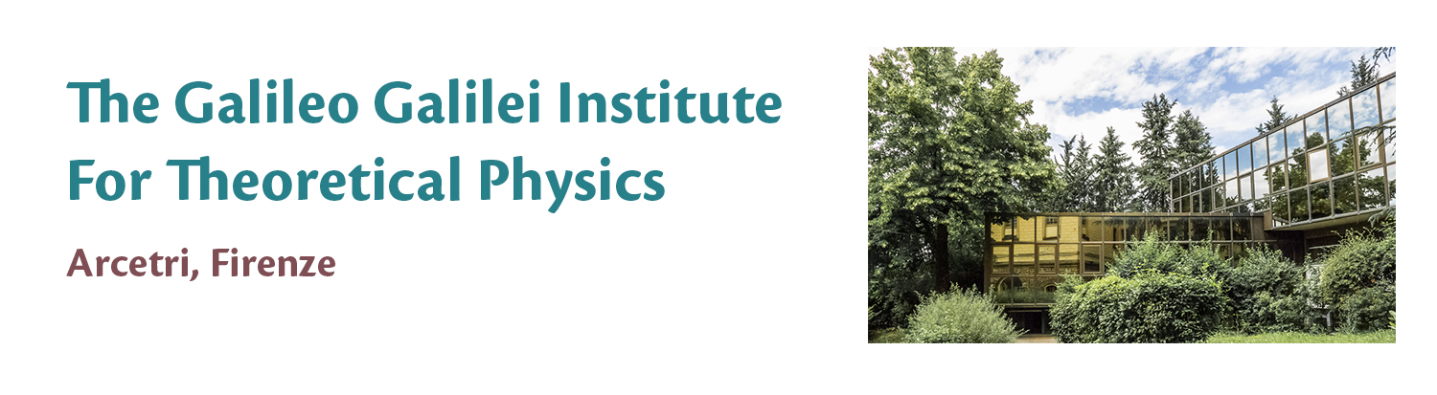

CCD
CCD-Based Dark Matter Search — Data Analysis and Background Characterization

Slide 2
Goal: CCD-Based Dark Matter Search — Data Analysis and Background Characterization
Dataset:
15 simulated CCD images
Each image corresponds to 1 kg·year
Pixel values are in arbitrary ADC units
Must convert ADC → electrons → energy (eV)
Backgrounds included:
Flat Poisson background (spatially uniform)
High-energy events producing clusters and halos

Slide 3
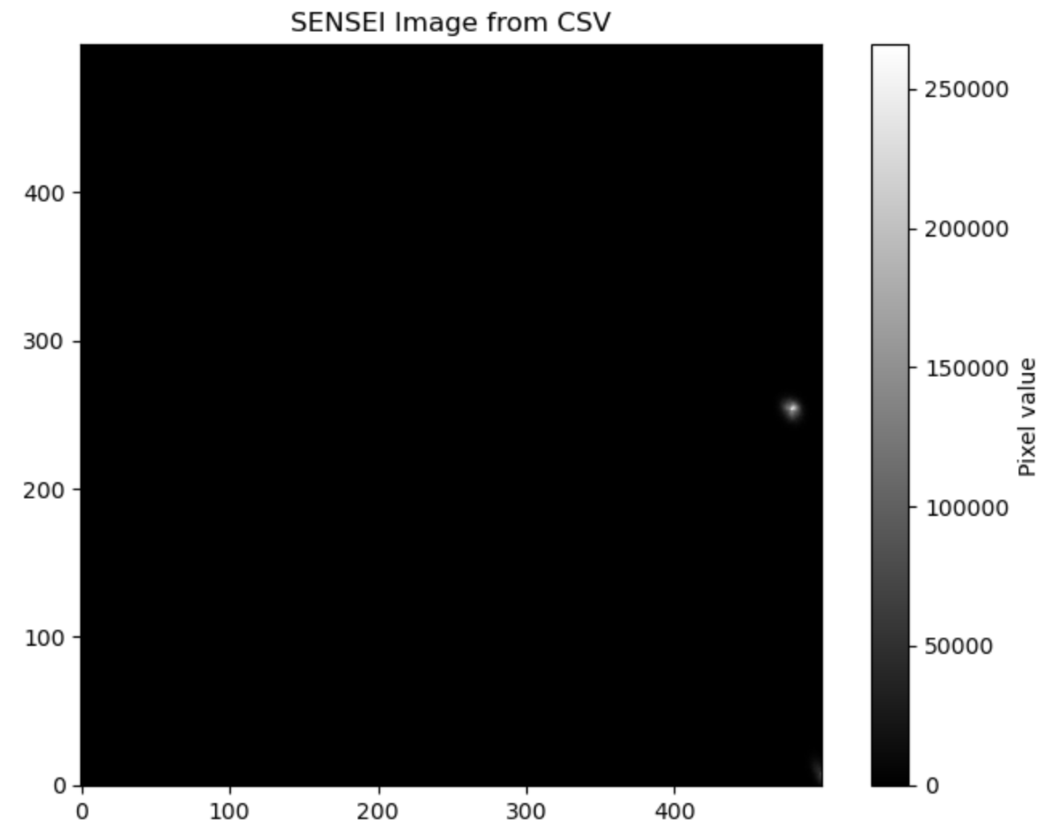
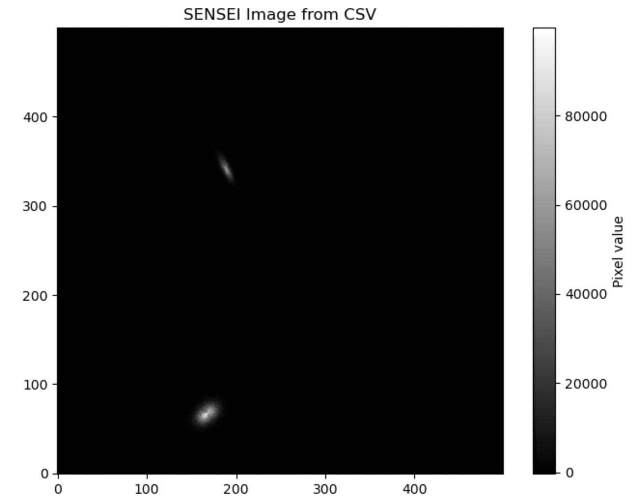
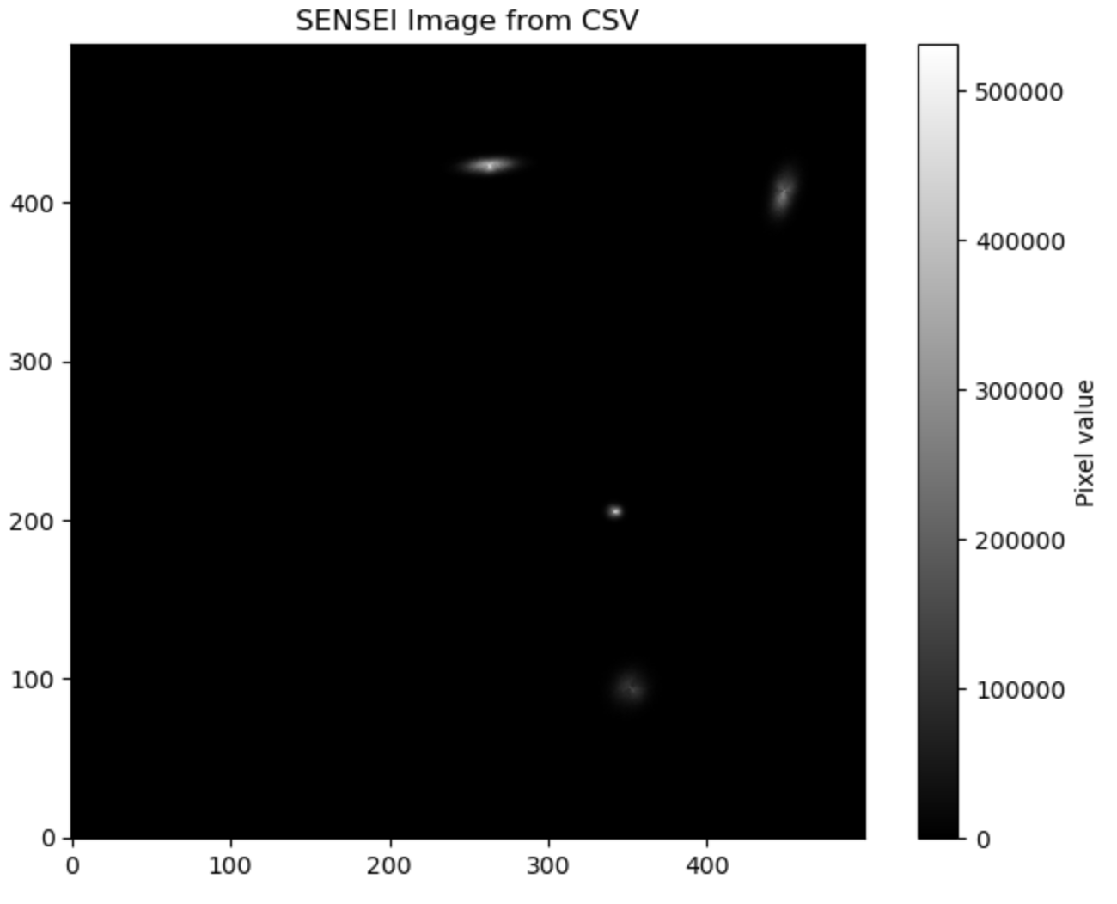
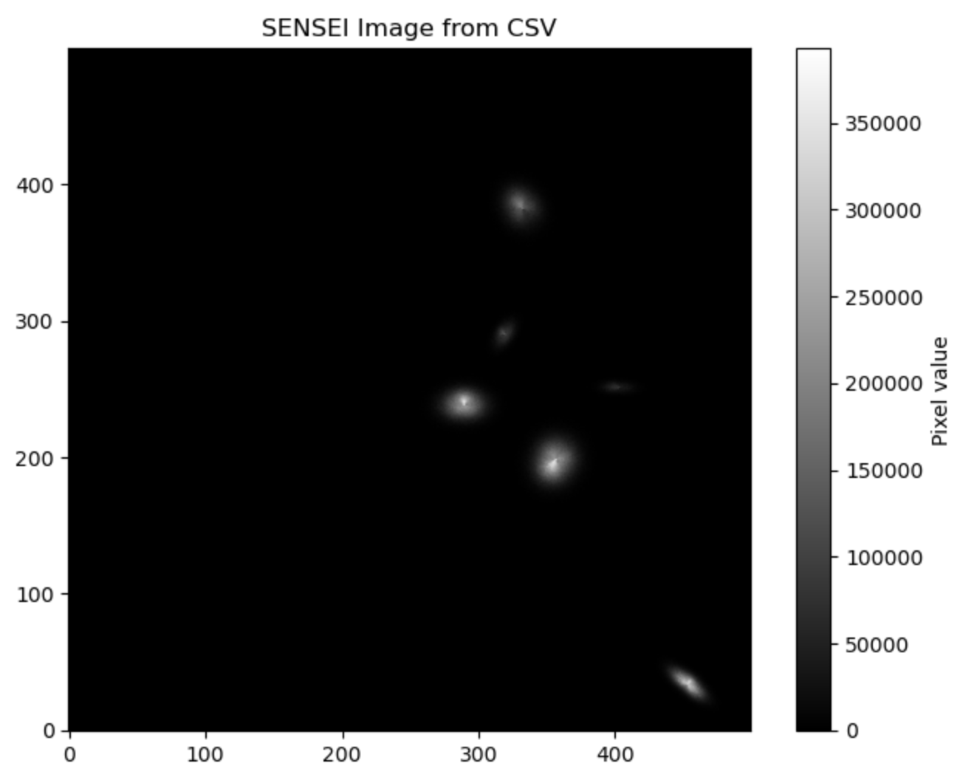

Slide 4
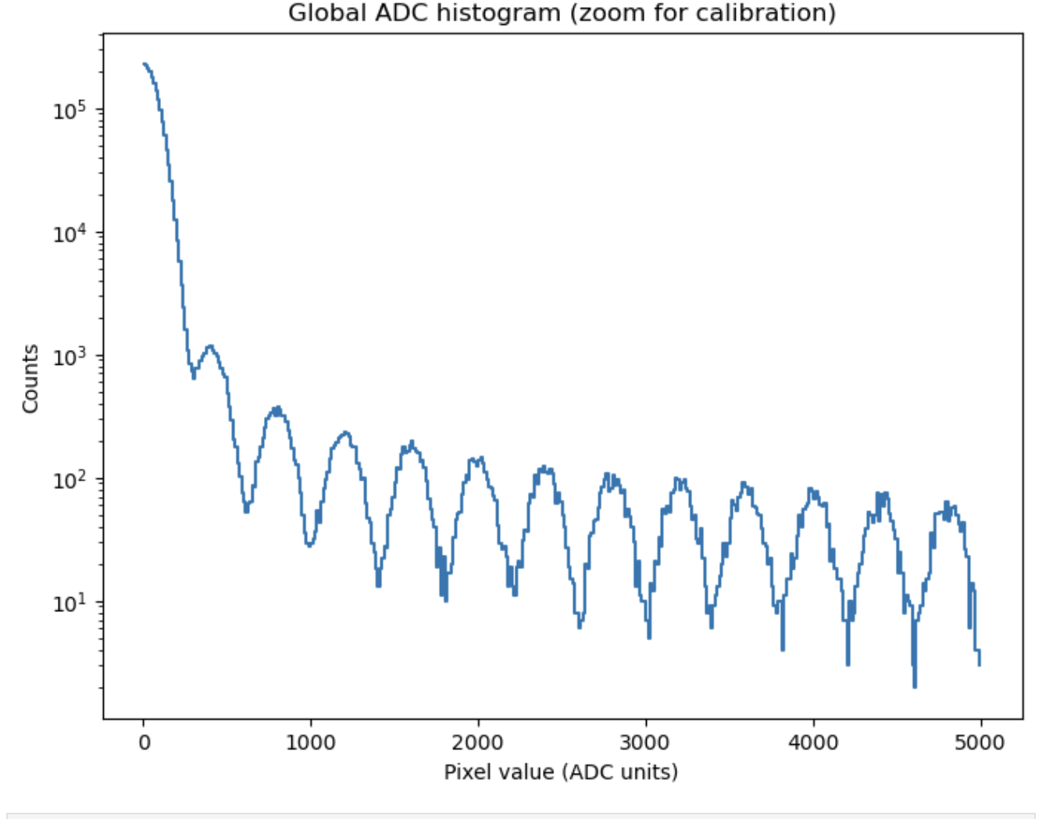

Slide 5
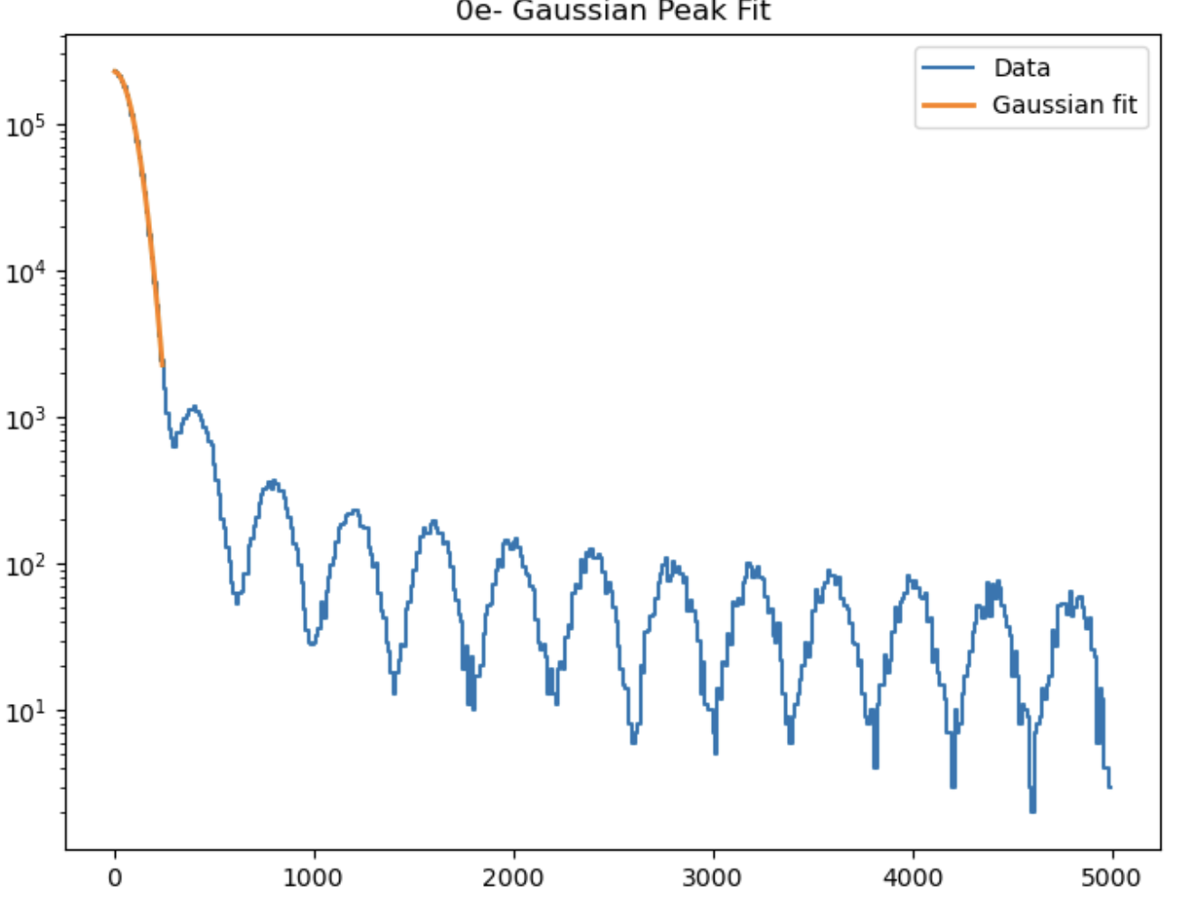
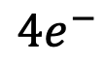
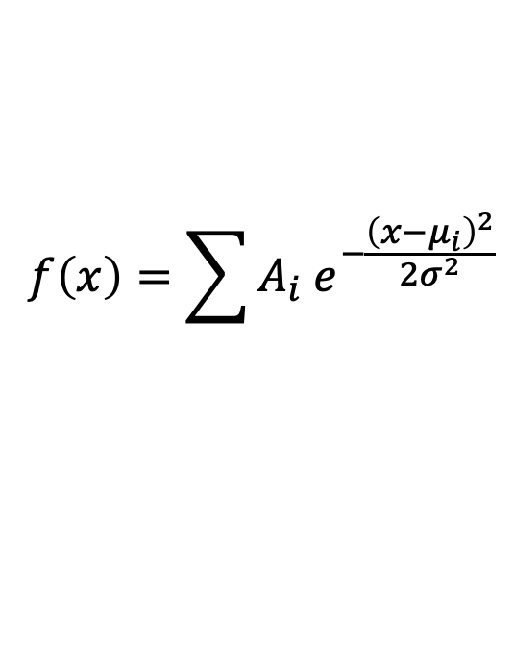
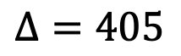
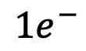
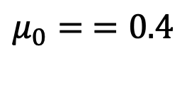
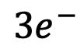
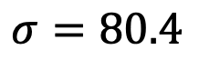
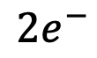
$$f\left(x\right)=\sum{A_{i} e^{−\frac{{\left(x−μ_{i}\right)}^{2}}{2σ^{2}}}}$$
$$σ=80.4$$
$$μ_{0}= =0.4$$
$$Δ=405$$
$$1e^{−}$$
$$2e^{−}$$
$$3e^{−}$$
$$4e^{−}$$

Slide 6
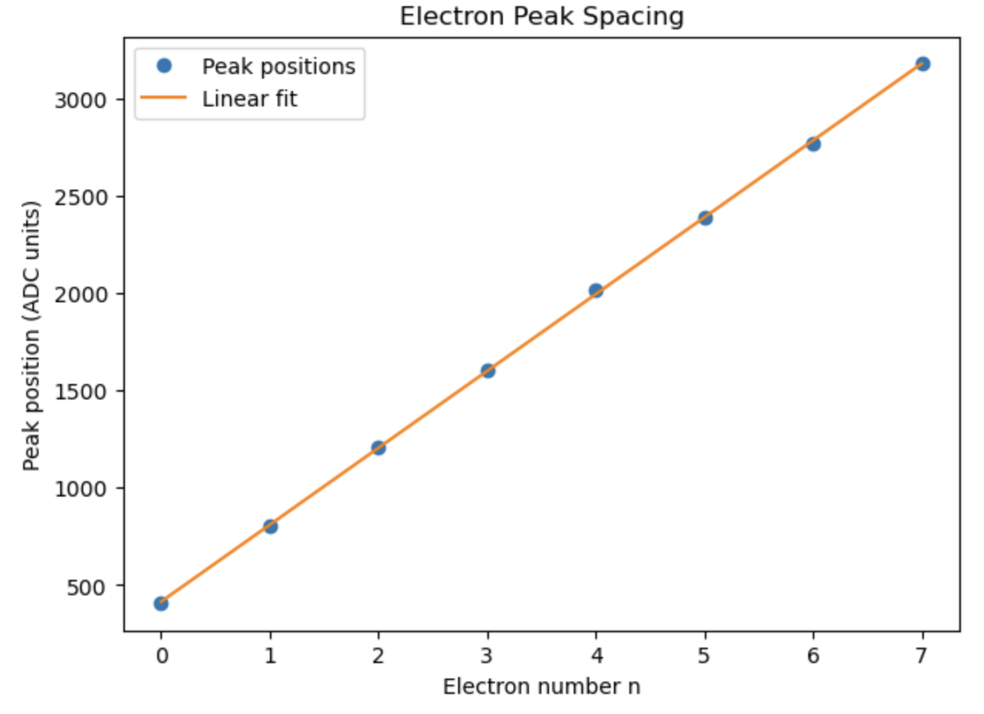
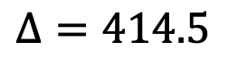
$$f\left(x\right)=\sum{A_{i} e^{−\frac{{\left(x−μ_{i}\right)}^{2}}{2σ^{2}}}}$$
$$σ=80.4$$
$$μ_{0}= =0.4$$
$$Δ=414.5$$

Slide 7
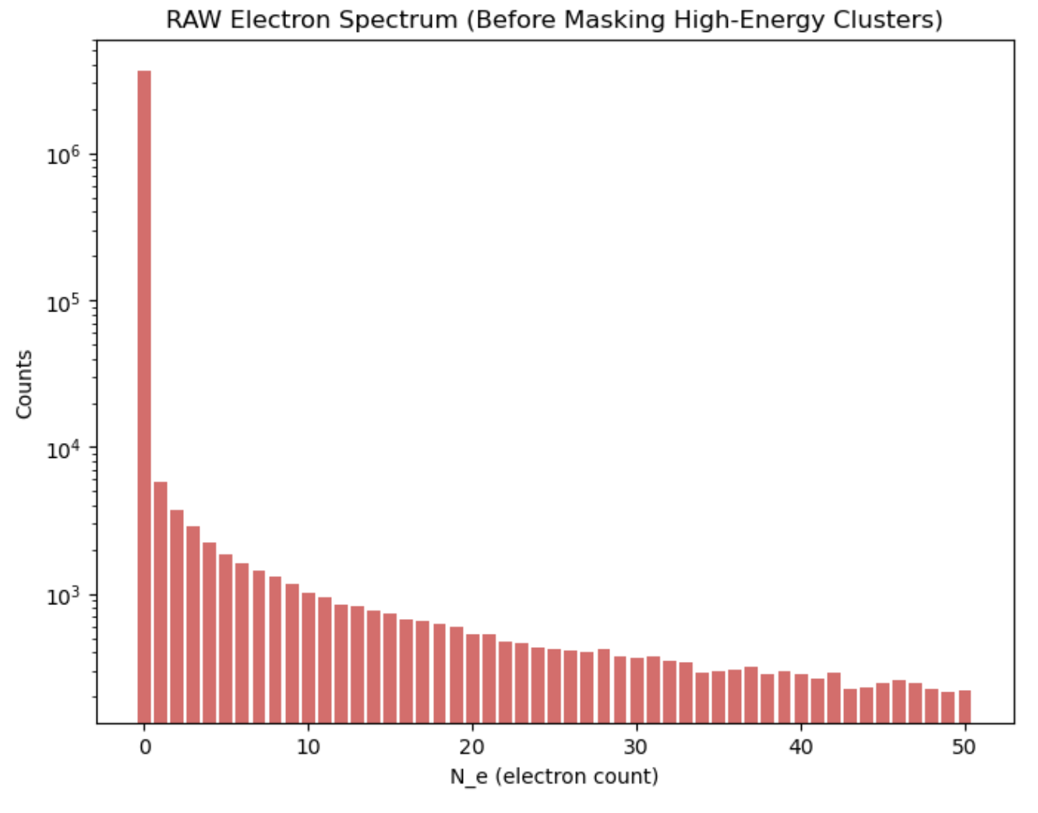
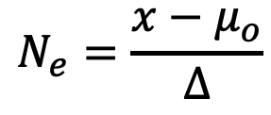
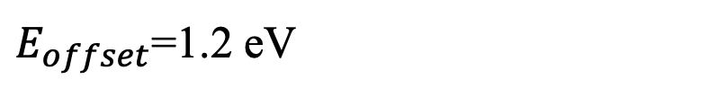
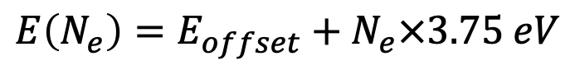
SENSEI (arXiv:1901.10478)
$$N_{e}=\frac{x−μ_{o}}{Δ}$$
$$E\left(N_{e}\right)=E_{offset}+N_{e}×3.75 eV$$
Ionization energy per pair
“Band gap” (move the electron from valence band to conduction band)
$E_{offset}$=1.2 eV
From Electrons to Energy

Slide 8
High-Energy Events and Their Contamination
High-energy particles:
cosmic rays
Compton electrons
gamma interactions
produce:
clusters with thousands of electrons
halos of 10–20 electrons around them
contaminating the few-electron region

Slide 9
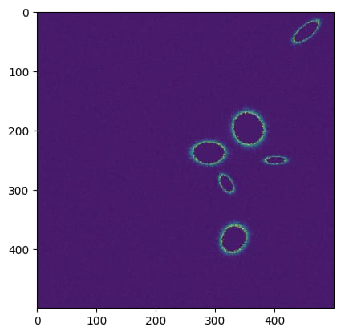
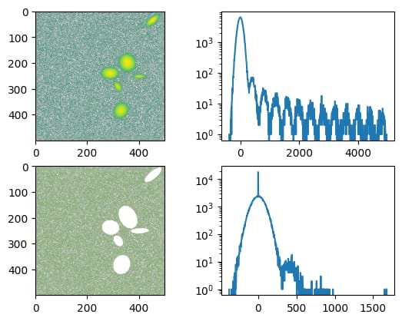

Slide 10
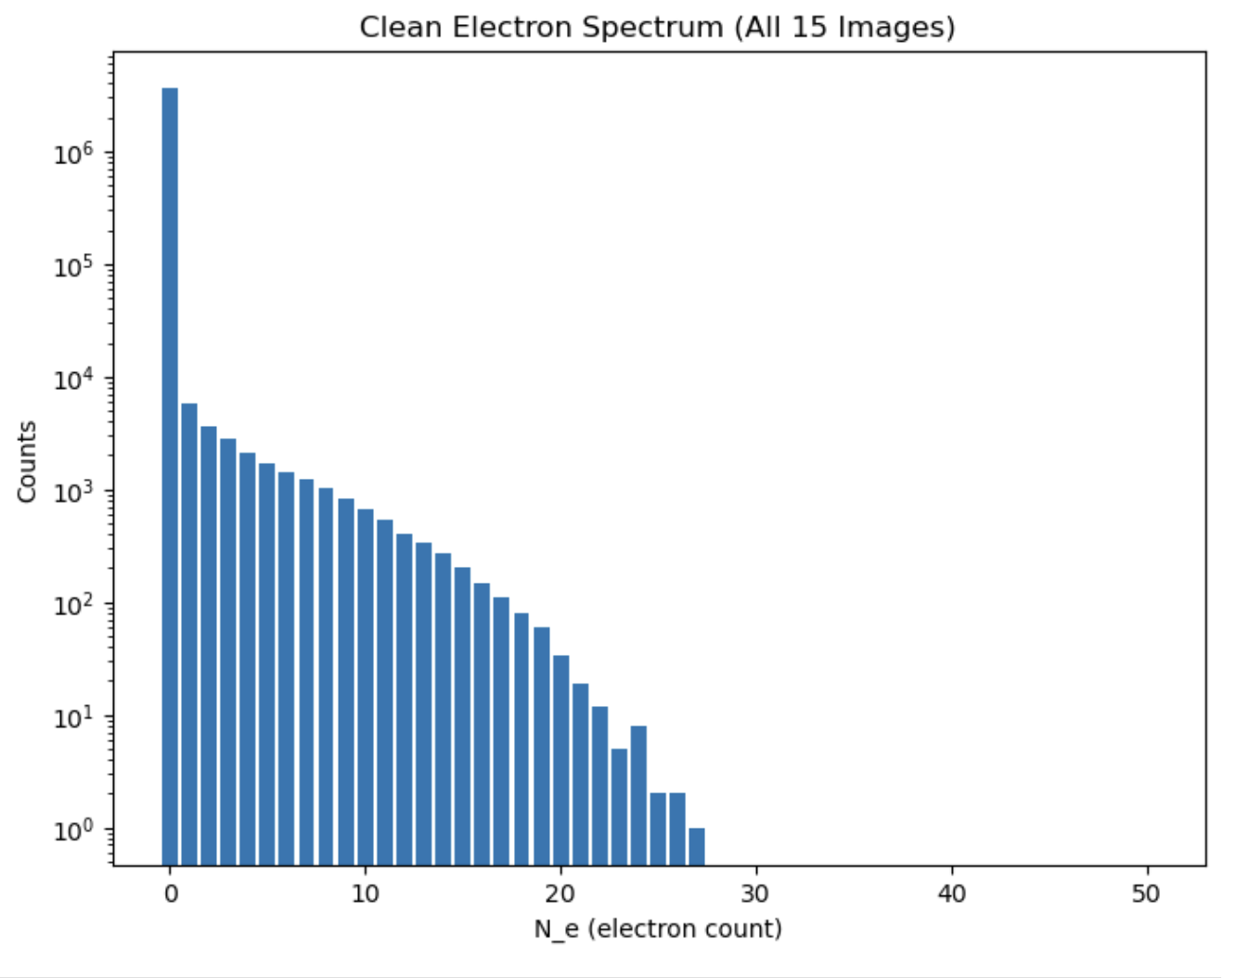
Removing High Energy events with constant cut= 30e

Slide 11
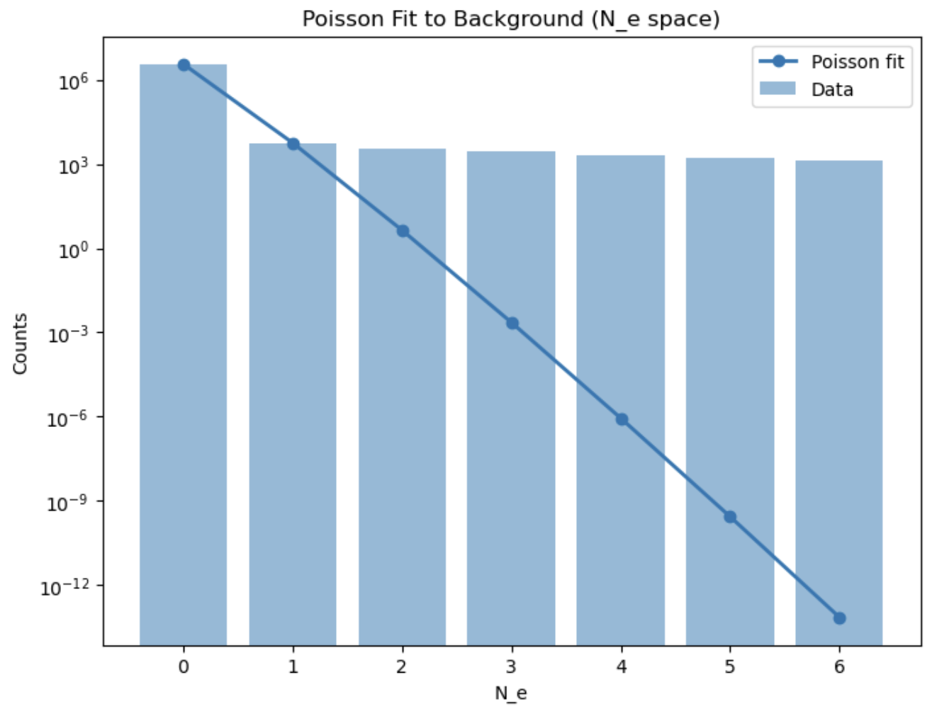
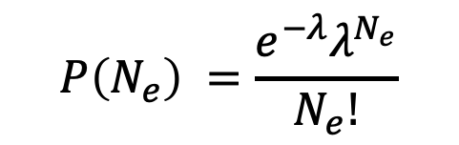

$$λ≈ 1.5 × {10}^{−3}$$
$$P\left(N_{e}\right) =\frac{e^{−λ}λ^{N_{e}}}{N_{e}!}$$

Slide 12
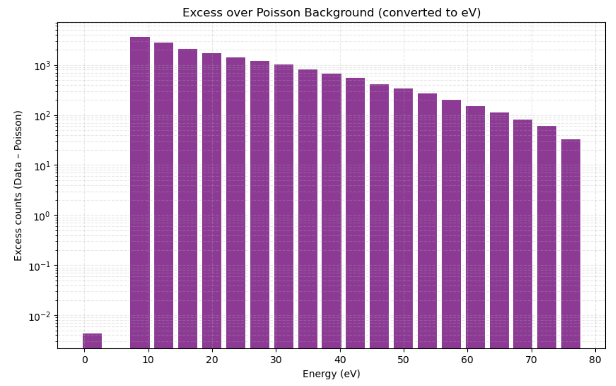
Excess Above the Poisson Background
$$Excess\left(N_{e}\right) = Data\left(N_{e}\right)− Poisson(N_e)$$
Everything above 1 electron originates from:
leakage of high-energy events
physical detector backgrounds
potential scattering of dark matter on electrons

Slide 13
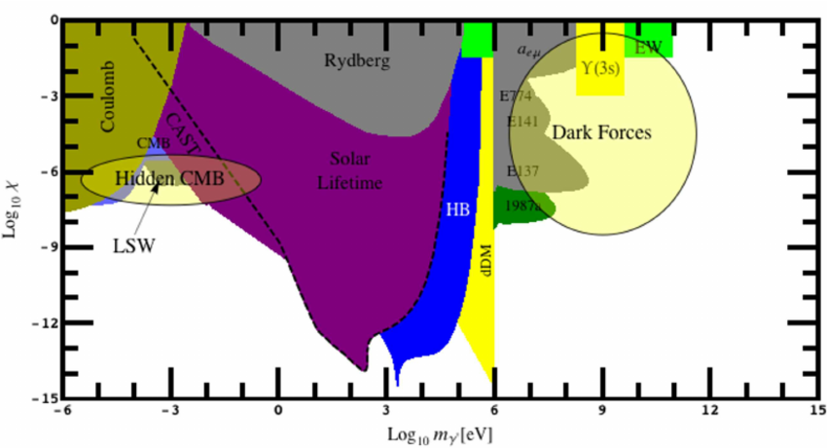
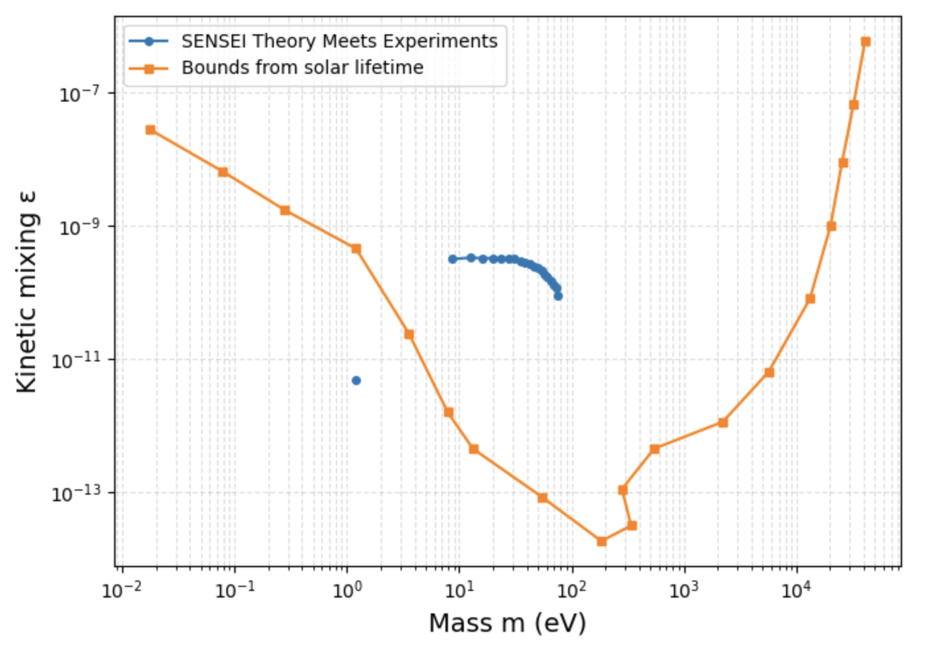
Connection to Dark Matter
Comparing the measured excess to DM models: QEdark

